Slide 1
Performing Role Transitions

Slide 2
Objectives
After completing this lesson, you should be able to:
  Explain the two database roles
  Perform a switchover
  Perform a failover

Slide 3

Role Management Services
  In a Data Guard configuration, a database operates in one of two mutually exclusive roles:
    Primary role
    Standby role
  With role management services, you can change these roles dynamically.
Notes:
Role Management Services
You can use role management services to change the primary and standby roles dynamically as a planned transition called a switchover operation, or as a result of a database failure through a failover operation.
For example, you might perform a switchover operation to transition the primary database to the standby role and transition a standby database to the primary role to perform routine maintenance tasks.

Slide 4
Role Transitions: Switchover and Failover
  Switchover
    Planned role reversal
    Used for operating-system or hardware maintenance
    Manually invoked
  Failover
    Unplanned role reversal
    Used in an emergency
    Minimal or no data loss (depending on the
    data-protection mode)
    Fast-start failover can be enabled for automatic failover
Notes:
Role Transitions: Switchover and Failover
Switchover
You can use the switchover feature to switch the role of the primary database to one of the available standby databases. The chosen standby database becomes the primary database, and the original primary database then becomes a standby database. There is no need to
re-create any of the databases involved in the switchover operation. There is no data divergence between the original and new primary databases after successful completion of the switchover.
Failover
You invoke a failover operation when a failure occurs on the primary database and there is no possibility of recovering the primary database in a timely manner. During a failover operation, the incapacitated primary database is removed from the Data Guard environment and a standby database assumes the primary database role. You invoke the failover operation on the standby database that you want to fail over to the primary role.
Note: You can enable fast-start failover to fail over automatically when the primary database becomes unavailable. When fast-start failover is enabled, the broker determines if a failover is necessary and initiates the failover to the specified target standby database automatically, with no need for DBA intervention and with no loss of data. For details, see the lesson titled “Enabling Fast-Start Failover.”

Slide 5
Switchover
  Transitions the roles of the primary and standby databases
  Requires no resetting of the online redo logs of the new primary database
  Incurs no data loss
Notes:
Switchover
A switchover operation transitions the primary database to the standby role and transitions the standby database to the primary role, without resetting the online redo logs of the new primary database.
If the switchover operation involves a physical standby database, both the primary database and the physical standby database that is switching over to the primary role are shut down and restarted. However, there is no need to shut down and restart any other standby databases that are not participants in the switchover operation. If the switchover operation involves a logical standby database, there is no need to shut down and restart either the primary database or any of the standby databases. Logical standby databases do not need to be shut down and restarted.
Note: When necessary, the broker automatically starts and stops all but one instance in a Real Application Clusters environment. If the broker is not used, this must be done manually.

Slide 6


Switchover: Before
Read/write
transactions
Primary
database
Application
San Francisco
Oracle Net
Boston
Standby
database
Read-only reports
Application
Notes:
Oracle Database 11g: Data Guard Administration 11 - <number>
Switchover: Before
As an example, suppose that the primary database is located in San Francisco and the physical standby database is located in Boston. Switchovers are started only on the primary database and completed on the target standby database. You can be connected to any database in the configuration through DGMGRL to execute the SWITCHOVER command.

Slide 7
Switchover: After
Read-only reports
Standby
database
Application
San Francisco
Oracle Net
Boston
Primary
database
Read/write
transactions
Application
Notes:
Oracle Database 11g: Data Guard Administration 11 - <number>
Switchover: After
After the switchover is completed, each database has the role opposite to the one that it had before the switchover. In our example, Boston is now the primary database and San Francisco is the standby database.
Because Data Guard does not automatically switch over sessions from one database to the other, active sessions for each system need to reconnect. See the lesson titled “Managing Client Connectivity” for information about configuring automatic methods to reconnect sessions.

Slide 8
Preparing for a Switchover
To prepare for the switchover operation, verify that:
  Network connectivity exists between the primary database and all standby database locations
  State of the primary database is TRANSPORT-ON and state of the standby database is APPLY-ON
  Standby database properties are set on the primary database
  Standby redo log files are configured on the primary database
  LogXptMode is set to SYNC if the configuration is operating in maximum availability or maximum protection mode
Notes:
Preparing for a Switchover
Before you execute the SWITCHOVER command, verify the following:
Each location in the Data Guard configuration has connectivity through Oracle Net to the primary database and to all associated standby databases.
The state of the primary is set to TRANSPORT-ON and the state of the standby databases is APPLY-ON.
There are no errors or warning for any of the participating databases.
The standby LogXptMode, DbFileNameConvert, LogFileNameConvert, StandbyArchiveLocation, and LogArchiveFormat database properties are set on the primary database, so that the primary database can function correctly when transitioned to a standby database.
The LogXptMode configurable database property is set to SYNC if the configuration is operating in either maximum availability mode or maximum protection mode.
Standby redo log files are configured on the primary database. Standby redo log configuration should be identical on the primary database and on any physical standby databases. Even though the standby redo logs are not used when the database is in the primary role, configuring the standby redo logs on the primary database is recommended in preparation for an eventual switchover operation.

Slide 9
Performing a Switchover by Using DGMGRL
After verifying the conditions required for a switchover, execute the SWITCHOVER command:
DGMGRL> SWITCHOVER TO 'pc00sby1';
Performing switchover NOW, please wait...
New primary database "pc00sby1" is opening...
Operation requires shutdown of instance "pc00prmy" on database "pc00prmy"
Shutting down instance "pc00prmy"...
ORA-01109: database not open
Database dismounted.
ORACLE instance shut down.
Operation requires startup of instance "pc00prmy" on database "pc00prmy"
Starting instance "pc00prmy"...
ORACLE instance started.
Database mounted.
Switchover succeeded, new primary is "pc00sby1"
Notes:
Performing a Switchover by Using DGMGRL
After verifying the conditions required for executing a switchover, execute the SWITCHOVER command to perform the switchover operation. The Data Guard broker performs the following operations:
1. Verifies that the primary database and target standby database are in the correct states
2. Shuts down all instances as necessary
3. Switches roles between the primary and standby databases
4. Updates the broker configuration file with the new role information
5. Restarts the new standby database
6. Opens the new primary database in read/write mode and starts redo transport services
Note: For detailed information about each step, see Oracle Data Guard Broker.

Slide 10
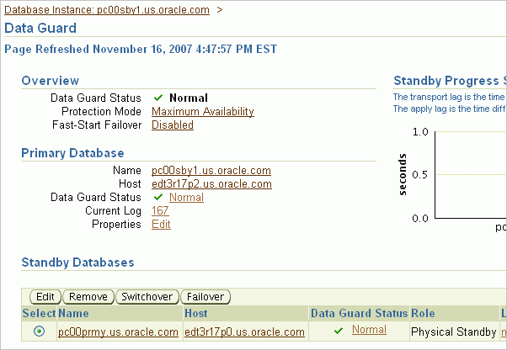
Performing a Switchover by Using Enterprise Manager
Select the database and
click Switchover.
Notes:
Performing a Switchover by Using Enterprise Manager
When it is used for the switchover, Enterprise Manager:
a. Checks to ensure that the primary database and standby database are not currently in an error status condition and that broker management of the primary database is enabled and online
b. Automatically closes any active sessions connected to the primary database during the switchover
c. First changes the primary database to the standby role, and then changes the standby database to the primary role
d. Restarts the target and primary databases if the switchover target is a physical standby database
To initiate a switchover by using Enterprise Manager:
1. On the Data Guard page, select the standby database that you want to become the primary database.
2. Click Switchover.
The Data Guard Switchover Confirmation page is displayed.

Slide 11
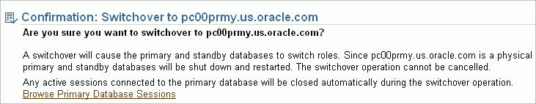

Performing a Switchover by Using Enterprise Manager
Click Yes to confirm.
Notes:
Performing a Switchover by Using Enterprise Manager (continued)
3. Click the Browse Primary Database Sessions link to view active sessions.
4. Click Yes to continue with the switchover, or click No to cancel.
You cannot cancel the switchover operation after it begins.

Slide 12

Performing a Switchover by Using Enterprise Manager
Notes:
Performing a Switchover by Using Enterprise Manager (continued)
The Data Guard Switchover Processing page displays the progress of the switchover operation as it:
Switches roles between the primary and standby databases (If the switchover target is a physical standby database, it is restarted along with the primary database.)
Waits for the Data Guard broker to complete the initialization tasks required to switch the database roles.
You can view the database alert log of the primary and standby databases by clicking the respective “View alert log” links. A new browser window opens with the content of the alert log.
After the switchover operation is complete, you are returned to the Data Guard page.

Slide 13
Considerations When Performing a Switchover to a Logical Standby Database
  The switchover operation does not cause a shutdown of the primary database instance.
  Although there is no need to terminate user sessions, termination is recommended.
  The logical standby database may not have all data.
  Switchover to a logical standby database invalidates and disables all physical and snapshot standby databases in the configuration.
Notes:
Considerations When Performing a Switchover to a Logical Standby Database
Unlike a switchover to a physical standby database, a switchover to a logical standby database does not require a shutdown of the primary database.
If you are switching over to a logical standby database, you do not need to terminate applications that are connected to the current primary database or to the logical standby database, because neither database is shut down during the switchover operation. However, because sessions on the old primary database may fail after the switchover operation is completed and the database guard is turned on, you should terminate such open sessions now. The database guard prevents users from making changes in the logical standby database.
If you switch over to a logical standby database, be aware that you may not have all of the data that was in your primary database if the logical standby database is only a subset of the primary database.
A switchover to a logical standby database invalidates and disables all physical and snapshot standby databases in the configuration. You must re-create the physical standby databases from a backup of the new primary database before you can reenable them.

Slide 14
Situations That Prevent a Switchover
You cannot perform a switchover if:
  Archived redo log files are unavailable.
  Point-in-time recovery is required.
  The production database is not open and cannot be opened.
Notes:
Situations That Prevent a Switchover
You cannot perform a switchover if:
Archived redo log files are unavailable: If there is a gap in the archived redo log files on the standby database, you cannot switch over to that standby database.
Point-in-time recovery is required: When you perform a switchover to a standby database, you always switch over to the current state of the primary database. You cannot switch over to a time in the past.
The production database is not open and cannot be opened: A switchover is initiated on the primary database while it is in the open state. If you cannot open the primary database, a switchover is not possible.

Slide 15



Failover
Local Archiving
Primary database
Online Redo
Logs
Archived redo
logs
San Francisco
Application
Boston
Read/write
transactions
Local archiving
Standby
database becomes primary database.
Online redo
logs
Archived redo
logs
Notes:
Failover
You invoke a failover operation when a failure occurs on the primary database and there is no possibility of recovering the primary database in a timely manner. During a failover operation, the primary database is removed from the Data Guard environment and a standby database assumes the primary database role. Failing over to a standby database is a permanent operation. You cannot undo the failover and return the database to its former role as a standby database. Because of this, you should invoke a failover operation only in an emergency.
It is not always necessary to fail over to the standby database. In some cases, recovery of the primary database may be faster. Most failures can be resolved at a primary database in a reasonable amount of time.
In a failover operation:
The original primary database is presumed to be lost. (If you want, you can reinstate or re-create the original primary database as a new standby database.)
Standby databases that are online at the time of the failover operation, but are not involved in the role transition, do not need to be shut down and restarted.

Slide 16
Types of Failovers
  Manual failover: Invoked by the DBA
    Complete: Attempts to minimize data loss by applying all available redo on the standby database
    Immediate: No additional data is applied on the standby database
  Fast-start failover: Invoked automatically by the Data Guard broker
Notes:
Types of Failovers
A manual failover is invoked through DGMGRL or Enterprise Manager. There are two types of manual failover:
Complete: The maximum amount of redo data for the protection mode is recovered. In this type of failover, the broker avoids disabling any standby databases that are not the failover target. Complete failover is the default and recommended type of failover.
Immediate: No additional redo data is applied to the standby database after the failover is invoked. This is the fastest type of failover. After an immediate failover, you must reenable the original primary database and all standby databases that were not a target of the failover.
Note: You should always try to perform a complete failover. Perform an immediate failover only when a complete failover is unsuccessful. Depending on the destination attributes of redo transport services, a complete failover can take place without incurring any data loss, while an immediate failover usually results in the loss of data.
You can configure fast-start failover so that the broker automatically fails over to a chosen standby database in the event of the loss of the primary database. For details, see the lesson titled “Enabling Fast-Start Failover.”

Slide 17
Failover Considerations
  Old primary database is no longer part of the configuration.
  Data loss is possible.
  Failover should be used only in an emergency.
  When choosing a standby database to fail over to, you should:
    Choose a physical standby database when possible
    Choose the standby database that is most current
Notes:
Failover Considerations
During a failover operation, a standby database transitions to the primary role and the old primary database is rendered unable to participate in the configuration. Depending on the protection mode under which the old primary database was operating before the failover, there may be some or no data loss during a failover.
A failover is typically used only when a primary database becomes incapacitated and there is no possibility of performing a switchover or successfully repairing the primary database in a reasonable amount of time.
The specific actions that are performed during a failover vary, depending on:
Whether a logical or physical standby database is involved in the failover operation
The state of the configuration at the time of the failover
The specific SQL commands that are used to initiate the failover

Slide 18
Performing a Manual Failover by Using DGMGRL
  Execute the FAILOVER command to initiate the failover operation:
  Reset the protection mode (if necessary).
  Reinstate the primary database to serve as a standby database in the configuration.
  Reinstate or re-create other disabled standby databases in the configuration.
DGMGRL> FAILOVER TO 'pc00sby1' [IMMEDIATE];
Notes:
Performing a Failover by Using DGMGRL
After determining that the primary database cannot be recovered in a timely manner, execute the FAILOVER command to perform the failover operation.
If you specify the IMMEDIATE option, no attempt is made to apply any unapplied redo that has been received.
The Data Guard broker performs the following operations for a complete failover:
a. Verifies that the target standby database is enabled
b. Stops Redo Apply after all unapplied redo data is applied to the target standby database
c. Transitions the target standby database to the primary database role by:
Opening the new primary database in read/write mode
Determining if any standby databases need to be reenabled
Starting redo transport services
For an immediate failover, the broker does not wait for all available redo data to be applied (as described in step b). For details about each step, see Oracle Data Guard Broker.

Slide 19
Reenabling Disabled Databases by Using DGMGRL
  Disabled databases must be reinstated or re-created to reenable broker management.
  Reinstate a database using REINSTATE DATABASE:
  If you cannot reinstate a database, re-create it from a copy of the primary database and then reenable the database by using ENABLE DATABASE:
DGMGRL> REINSTATE DATABASE pc00prmy;
DGMGRL> ENABLE DATABASE pc00prmy;
Notes:
Reenabling Disabled Databases by Using DGMGRL
After a failover, you may need to reinstate or re-create databases in your configuration.
If a database can be reinstated, the database has the following status after a complete failover:
ORA-16661: the standby database needs to be reinstated
Note: To reinstate a database, Flashback Database must have been enabled on the database prior to the failover and flashback logs must be available.
To reinstate the database:
1. Start the database instance and mount the database.
2. Invoke DGMGRL and connect to the new primary database.
3. Use the REINSTATE DATABASE DGMGRL command to reinstate the database.
If a database must be re-created, it has the following status after the failover:
ORA-16795: the standby database needs to be re-created
You must re-create the standby database from a copy of the primary database and then reenable it by using the ENABLE DATABASE DGMGRL command.

Slide 20
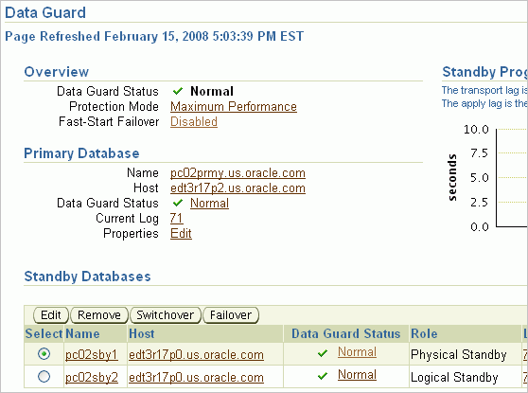
Performing a Failover by Using Enterprise Manager
Select the database and
click Failover.
Notes:
Performing a Failover by Using Enterprise Manager
Perform a failover only in the event of a software or system failure that results in the loss of the primary database. The failed primary database is disabled by the broker and must be re-created. The standby database then assumes the primary database role.
To initiate a failover by using Enterprise Manager:
1. On the Data Guard page, select the standby database that you want to become the primary database.
2. Click Failover.

Slide 21
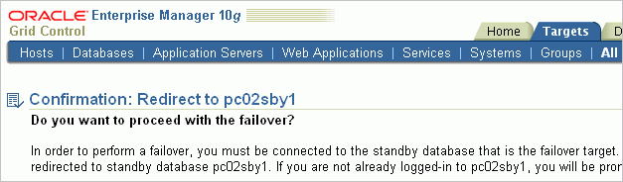

Performing a Failover by Using Enterprise Manager
Notes:
Performing a Failover with Enterprise Manager (continued)
3. Click Yes to confirm that you want to proceed with the failover operation.

Slide 22
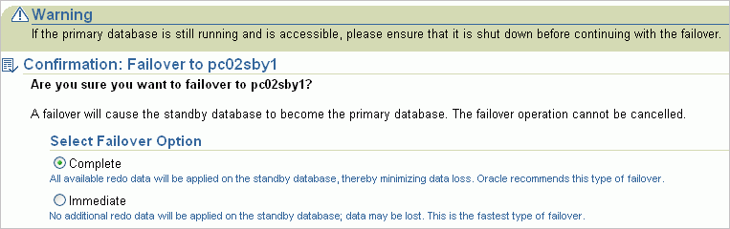
Performing a Failover by Using Enterprise Manager
Select the failover type and click Yes.
Notes:
Performing a Failover with Enterprise Manager (continued)
On the Data Guard Failover Confirmation page, specify the type of failover that you want to perform:
Complete: All available redo is applied on the standby database. Oracle Corporation recommends that you specify this type of failover.
Immediate: No additional data is applied on the standby database, resulting in a data-loss failover. An immediate failover should be used only when a complete failover is not possible.
5. Select the failover option, and click Yes to confirm the failover operation.

Slide 23
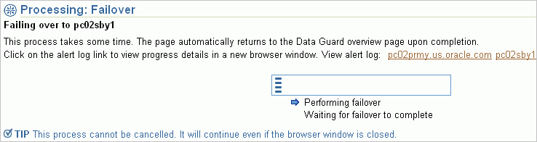
Performing a Failover by Using Enterprise Manager
Notes:
Performing a Failover with Enterprise Manager (continued)
After you click Yes, the Failover Processing page displays the progress of the failover operation.
You cannot cancel this operation after it begins.

Slide 24
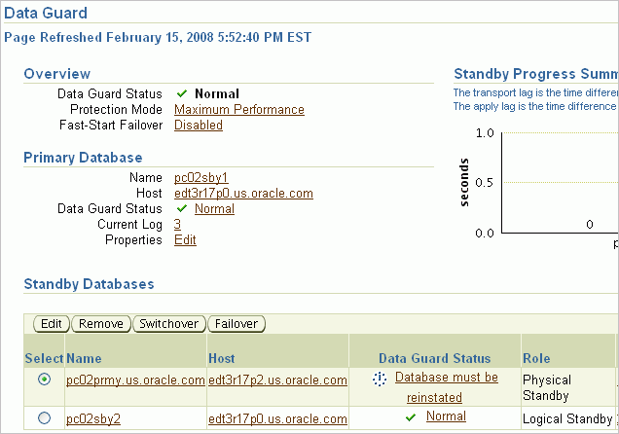
Performing a Failover to a Physical Standby Database
The physical standby database needs to be reinstated.
Notes:
Performing a Failover to a Physical Standby Database
During the failover operation, the selected standby database transitions into the primary role. The failover target (a physical standby database) is restarted. When the operation finishes, the Data Guard Overview page reflects the updated configuration.
After a complete or immediate failover, the primary database and some standby databases may need to be reinstated or re-created. To reinstate the database, click the “Database must be reinstated” link. Then click Reinstate on the General Properties page. Enterprise Manager reinstates the database as a standby database to the new primary database.
Note: Flashback Database must have been enabled on the database prior to the failover, and the required flashback logs must be available on that database for reinstatement to succeed. In addition, the database to be reinstated and the new primary database must have network connectivity.

Slide 25
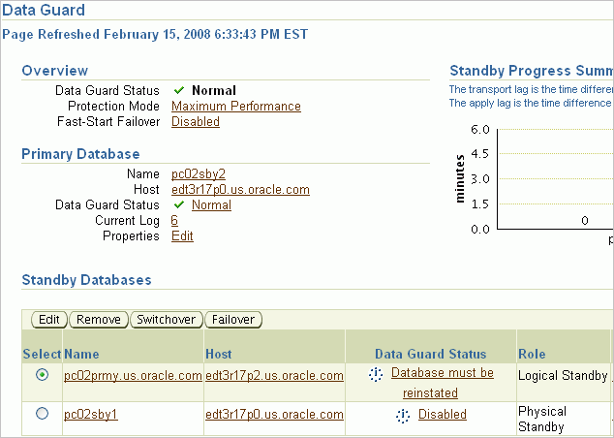
Performing a Failover to a Logical Standby Database
The logical standby database is now the primary database.
The physical standby database is disabled.
Notes:
Performing a Failover to a Logical Standby Database
When you perform a failover to a logical standby database, any physical standby databases in the configuration are permanently disabled after the failover and are no longer usable. These databases must be re-created from the new primary database.

Slide 26
Summary
In this lesson, you should have learned how to:
  Use DGMGRL to perform switchover and failover operations
  Use Enterprise Manager to perform switchover and failover operations

Slide 27
Practice 11: Overview
This practice covers performing a switchover:
  With DGMGRL
  With Enterprise Manager Grid Control

